Slide 1
Problem Debts #2: External dispute resolution
Khai Der Lau
Credit, Debt, and Consumer Lawyer, RLC

Slide 2
Acknowledgement of Country

Slide 3
Outline
What is External Dispute Resolution (EDR)?
Benefits of EDR
Overview of major EDR schemes
Case Study
Questions

Slide 4
External Dispute Resolution (EDR)

Slide 5
EDR vs IDR
Internal Dispute Resolution (IDR) is an attempt to resolve the matter directly with the service provider, or a complaints process.
IDR is often a mandatory step before EDR.
If an IDR complaint has not been made, find the IDR contact details through the EDR scheme's website:
Financial firms: https://my.afca.org.au/ff-search/
Telecom: https://www.tio.com.au/members/who-we-work-with
Energy or water company: https://www.ewon.com.au/page/suppliers/list-of-member-providers

Slide 6
What is EDR?
A free service for resolving disputes between consumers and members of an EDR scheme.
There are different EDR schemes for different industries:
Financial
Telecommunication
Energy
Membership of the EDR scheme is compulsory for most industry participants.
EDR action is an alternative to going to court when attempts to resolve a dispute internally (IDR) with a service provider have been unsuccessful.

Slide 7
Disputes not covered by EDR
Many disputes have Alternative Dispute Resolution available (e.g., negotiation, mediation) but not EDR, including:
Disputes between individuals
Disputes with private companies that do not have to be part of an EDR scheme (i.e., most companies that are not financial, telecommunication, or energy based)
Most disputes between businesses.
Seek legal advice to determine what options are available.

Slide 8
When should you go to EDR?
You can make an application to EDR if:
You have received an unsatisfactory IDR response, OR
The dispute remains unresolved after a reasonable period of time.

Slide 9
EDR: When should you seek legal advice?
Consider:
Is there a legal complaint (eg, breach of credit law)?
Is there a non-legal complaint (eg customer service)?
Was there a refusal of financial hardship?
Is there a statement of claim or threat of legal action?
If there is a suspicion of a legal issue, we recommend you get legal advice before starting EDR (or IDR, if you haven't yet!)

Slide 10
Red flags – time to refer to lawyer!
Client was on a Centrelink income when they were approved by a lender.
Client has multiple loans or leases at the same time.
Client has a significant vulnerability (domestic violence, language barrier, disability) that was exploited by the creditor.
The debt is 6 years old or more

Slide 11
How do you lodge your dispute with EDR?
Normally, you have to lodge in writing.
Some EDR schemes will accept complaints over the phone.
EDR schemes will provide translators and can work with the National Relay Service.
EDR schemes have representation allowed, and a signed authority is generally required.

Slide 12
EDR process
Complaint lodged
Request for information from another organisation.
Information requested from you
Conciliation, investigation or negotiation
Agreed outcome or determination

Slide 13
Benefits of EDR

Slide 14
EDR is independent
The schemes discussed here are independent.
All of these schemes have been assessed by the Information Commissioner as:
Independent of the sector
Fair and transparent
Accountable to the public
Efficient and effective
Accessible

Slide 15
Benefits of EDR
Free for consumers and easy to access.
EDR decisions are binding on the service provider and other party, but generally do not bind the consumer complainant unless agreed upon.
Complainants (consumers) retain their legal rights to take their matter to court if they do not agree with the outcome of EDR.
An EDR complaint can give the consumer extra time to deal with their financial hardship.

Slide 16
Debt collection – halting with EDR
Bill overdue
Demand
Court

Slide 17
Deadlines & EDR
A statement of claim is a document that starts court proceedings.
It must be personally served on the client or posted by the Court.
The Creditor or Debt Collector is the “plaintiff”.
The Debtor is the “defendant”.
The defendant has 28 days to respond.
If no response, after 28 days, the plaintiff can apply for default judgment.
Judgment can be enforced through the Court.
Get legal advice immediately!
Defence can be argued at EDR.

Slide 18
EDR may prevent court action
AFCA – for the duration of the EDR
TIO – for the duration of the EDR
EWON – the earlier of:
  (a) 90 days after lodgement of complaint; and
  (b) the date that EWON closes or resolves the complaint.

Slide 19
EDR v Court – Benefits of EDR
Costs orders can be made against the unsuccessful party in court.
Evidence standards are higher at Court than EDR.
Legal representation is expensive/unattainable for most people.
Easier to get extensions in EDR.
Court takes more time away from work and commitments.

Slide 20
Overview of major EDR schemes

Slide 21
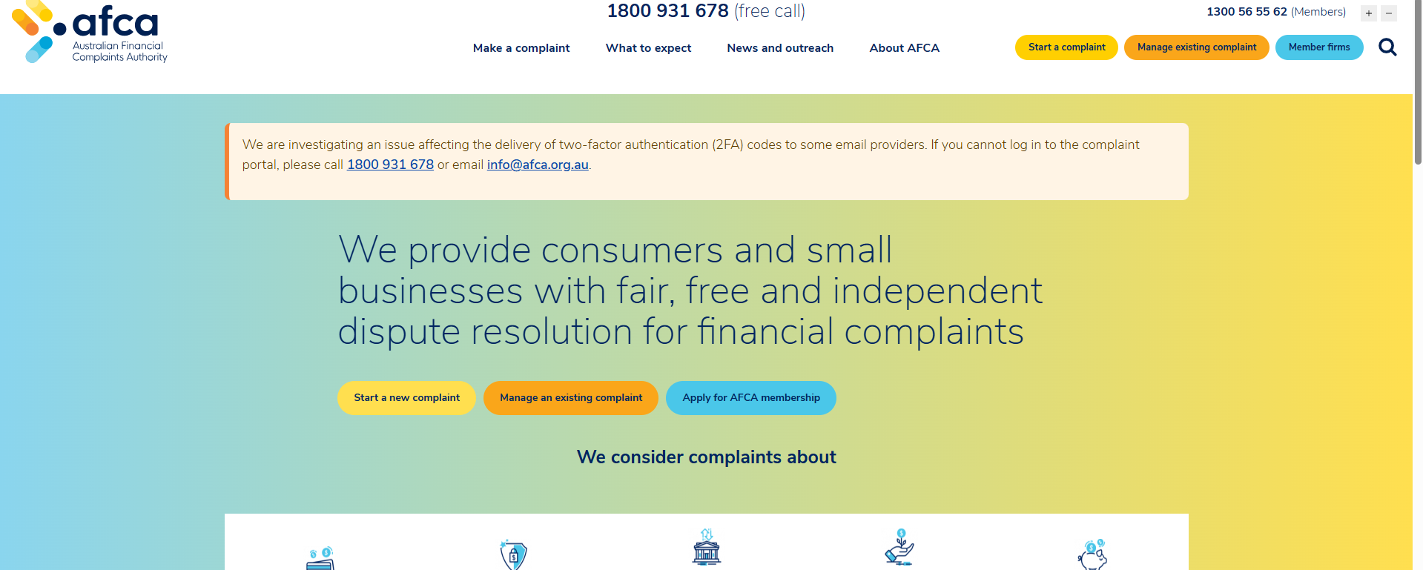
Australian Financial Complaints Authority (AFCA)

Slide 22
Australian Financial Complaints Authority
Considers complaints about financial firms including banks and finance companies (including Buy Now Pay Later providers), superannuation providers, and most general and life insurance companies (including motor vehicle insurers not paying out not-at-fault uninsured drivers in a motor vehicle accident).
If the consumer accepts AFCA's decision, it is binding. If the consumer rejects AFCA's decision, it is not binding, and the consumer can take the dispute to Court, except in Superannuation complaints.
Time limit
Generally 6 years from when you became aware of the problem, or 2 years from the final IDR response, whichever is earlier.
For certain issues related to credit contracts, such as financial hardship, it is 2 years after the end of the credit contract, or 2 years from the final IDR response, whichever is later.
Can be extended in some cases.

Slide 23
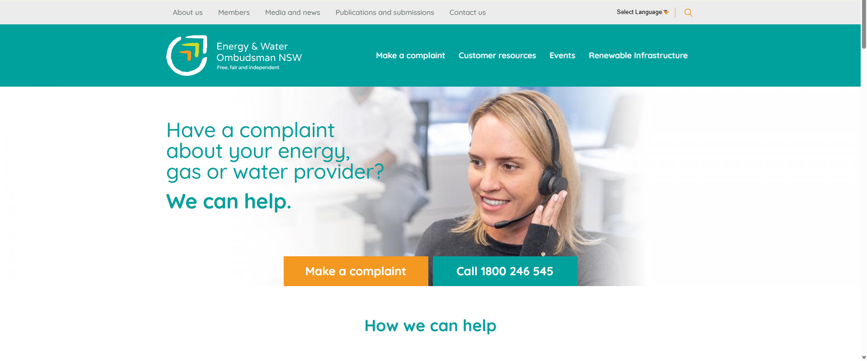
Energy & Water Ombudsman NSW (EWON)

Slide 24
Energy & Water Ombudsman NSW (EWON)
Can consider complaints for electricity, gas, and water providers about disconnection, supply issues, billing, credit issues, customer transfers, and back billing.
A review of the decision can be requested within 28 days.
The decision is binding on the provider if the consumer accepts it.
Time limit: You have 12 months from first becoming aware of the problem to complain to EWON.
EWON can decide to look at older complaints if they think it is fair.

Slide 25
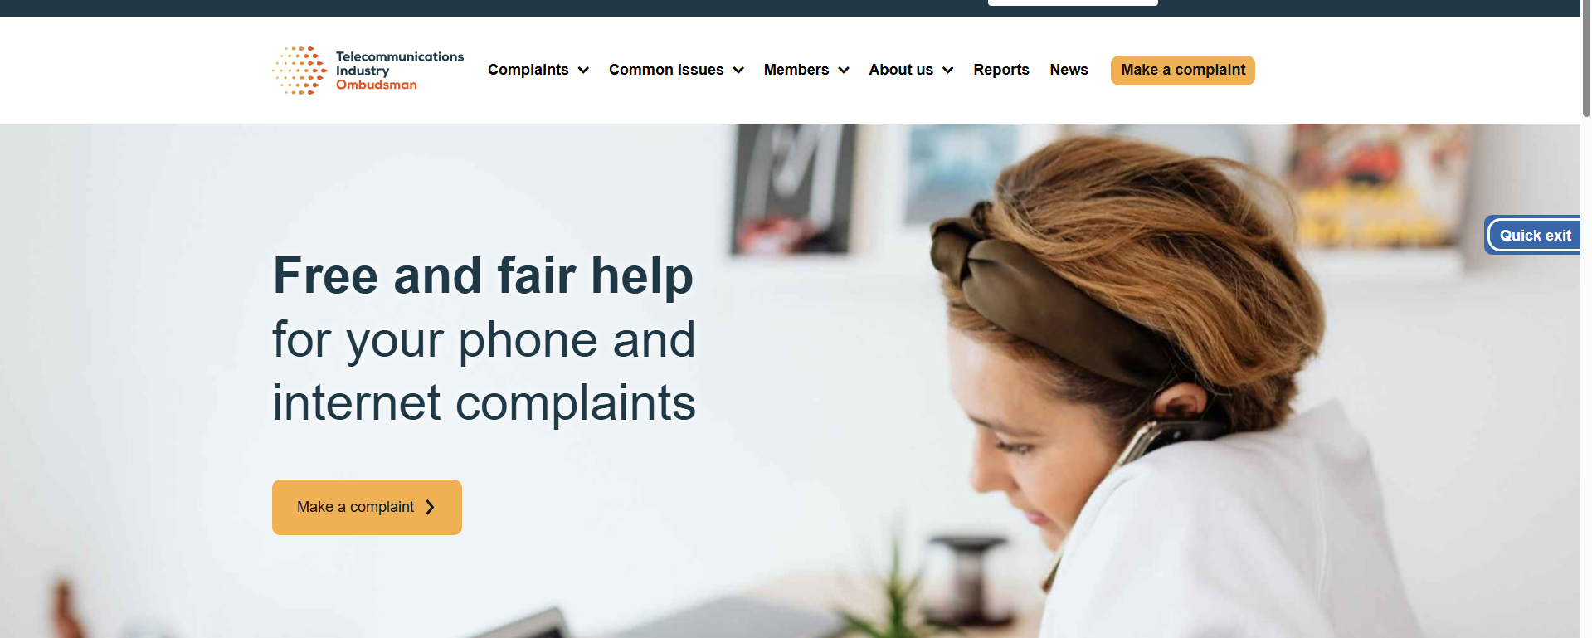
Telecommunications Industry Ombudsman (TIO)

Slide 26
Telecommunications Industry Ombudsman (TIO)
Can consider complaints about contracts, overcharging, new services, debt collection, exit fees, faults, and dropouts.
If a review is offered to a decision, must be requested within 10-15 business days (correspondence will indicate which).
Can bind an organisation up to $100,000 and assist with referrals and support above $100,000.
Time limit: You have 2 years to complain to the TIO, from when you first found out about the problem.
TIO can also look at complaints going back 6 years if they think it's fair.

Slide 27
Other EDR schemes
Tolling Customer Ombudsman (VIC & QLD)
NSW Tollway Ombudsman
Commonwealth Ombudsman
NSW Ombudsman and equivalents in other states and territories
Office of the Australian Information Commissioner
Information and Privacy Commission NSW and equivalents in other states and territories

Slide 28
Case study

Slide 29
Simon's story
30 years old.
Disability support pension since 21 years old.
Living with parents in social housing. Dropped out of University to care for father, an age pensioner, who has dementia and needs support getting to appointments.
He has no significant assets or savings.
He comes to an appointment with you with a folder full of documents, overwhelmed and struggling to manage a number of debts. He hands you a Statement of Claim, an electricity bill, 2x letters from different debt collectors. He was also involved in a car accident, but the other driver's insurer is not paying him enough money to fix his car.

Slide 30
Prioritise!
What has the most immediate legal consequences?
What is causing your client the most stress?
Can you seek assistance from another service for some of this work?
Bill overdue
Demand
Court
Car accident
Electricity bill
Letters from the debt collectors
Statement of Claim

Slide 31
Simon's story: Statement of Claim
The Statement of Claim is for a $20,000 limit credit card.
The debt has increased to $28,000 with interest, legal fees, and charges.
Simon was in receipt of the Disability Support Pension when he obtained the credit card, and used it to pay for essentials for himself and his family.
What should you do?
An application must be submitted to AFCA within 28 days of receiving the Statement of Claim, specifically regarding responsible lending and financial hardship.

Slide 32
Simon's story: Letter from Debt Collector #1
Simon has received a letter from a debt collector demanding repayment for a payday loan that he took out 8 years ago – he tells you he knows it was then, because it was used to pay for furniture. He was unable to make any repayments.
He has moved several times before settling with his parents and hasn't heard anything else about the loan since.
Try IDR first – if it fails, get legal advice and lodge a complaint with AFCA on the basis of:
Outside 6-year time limit.
Financial hardship.

Slide 33
Simon's story: Letter from Debt Collector #2
A debt collector has been calling every day and at night about a mobile phone debt. They have sent a letter stating they will initiate legal proceedings if they are not paid the $3,000 they claim is owed to them.
Simon added an iPhone to a phone plan 2 years ago, raising his phone bill from $20 per month to $90 per month. He could no longer afford it, and when he rang up to bring it up, a customer service representative was rude to him, so he gave up and stopped paying. He's been on a prepaid arrangement for a year.
Try IDR first – if it fails, get legal advice and lodge a complaint with AFCA and/or TIO on the basis of:
Breach of debt collection guidelines;
Not offering him options when he rang about financial hardship
Financial hardship.

Slide 34
Simon's story: Car accident
3 months ago, Simon was hit by another car while driving. Simon only had CTP insurance at the time, as he could not afford to pay the premiums for a third-party property or comprehensive car insurance policy.
The other driver was insured. Both the other driver and their insurer admit the other driver was at fault in the accident because the other driver entered Simon's lane.
The insurer is only offering to pay Simon $3,000 for the damage to his car. Simon reckons it will cost him $6,000 to fix his car. Simon really needs a working car for his own mobility, and to drive his father to medical appointments.
Begin with a letter of demand to the insurer's IDR; escalate to EDR at AFCA if unsuccessful. This applies to uninsured motor vehicle accidents costing less than $16,300.

Slide 35
Simon's story: Electricity bill
Simon agreed to have the electricity bill in his name when he moved in with his parents four years ago, as his father was still covering other expenses for the house.
He's just received a $4,000 electricity bill for 12 months' worth of charges he didn't know about after a faulty meter was replaced.
Start with an IDR complaint; if unsuccessful, make a complaint to EWON:
Back billing breach; and
Financial hardship.

Slide 36

Questions
RESOURCES: https://rlc.org.au/resources

Slide 37
Free, confidential legal advice
Legal Aid NSW 1300 888 529
www.legalaid.nsw.gov.au
Community legal centres
www.clcs.org.au/legal-help
Financial Rights Legal Centre (legal advice and financial counselling for people across Australia) https://financialrights.org.au
National Debt Helpline 1800 007 007 (financial counselling)
www.ndh.org.au

Slide 38
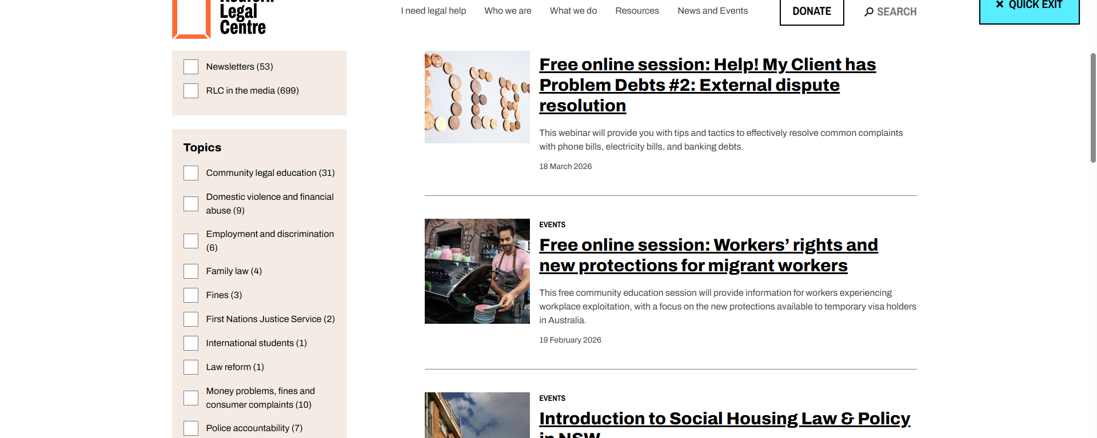
Community legal education – free webinars & recordings

Slide 39
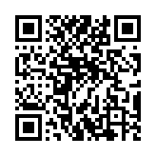
Your feedback is important to us!
Scan the QR code >>>

