Slide 1
26 September 2024
Terminations of
Residential Tenancies in NSW (and how to challenge them)

Slide 2
Alison Mackey
Solicitor & Tenants’ Advocate
Inner Sydney Tenants Advice & Advocacy Service
Redfern Legal Centre

Slide 3
Acknowledgement of Country

Slide 4

Outline
Overview of the termination process
When can a tenant be evicted?
When can a tenant terminate the tenancy agreement?
Unlawful lockouts
Questions and where to get help
Resources: www.rlc.org.au/training/evictions

Slide 5

1
Overview of the termination process

Slide 6
Overview of the Termination Process
Notice of termination
Application to NCAT - NSW Civil and Administrative Tribunal
NCAT hearing
NCAT orders termination and possession
NCAT issues warrant for possession
Office of NSW Sheriff executes warrant for possession; locks are changed.

Slide 7
Termination Process:
1. Notice of Termination
A valid notice of termination should include:
the address of the residential premises
the date on which the tenancy agreement is terminated AND the date by which vacant possession of the premises is to be given
the ground for the notice (reason for terminating the tenancy).
TENANTS DO NOT HAVE TO MOVE OUT on the date on the Notice of Termination.

Slide 8
Termination Process:
2. Application to NCAT
If the tenant is still in the premises after the date of vacant possession, the landlord has to apply to NCAT for orders for termination/possession.
The landlord cannot just change the locks of the premises or bring police to get a tenant out.
There are some circumstances where a landlord (or a tenant) can apply directly to NCAT for termination orders without first issuing a notice of termination.

Slide 9
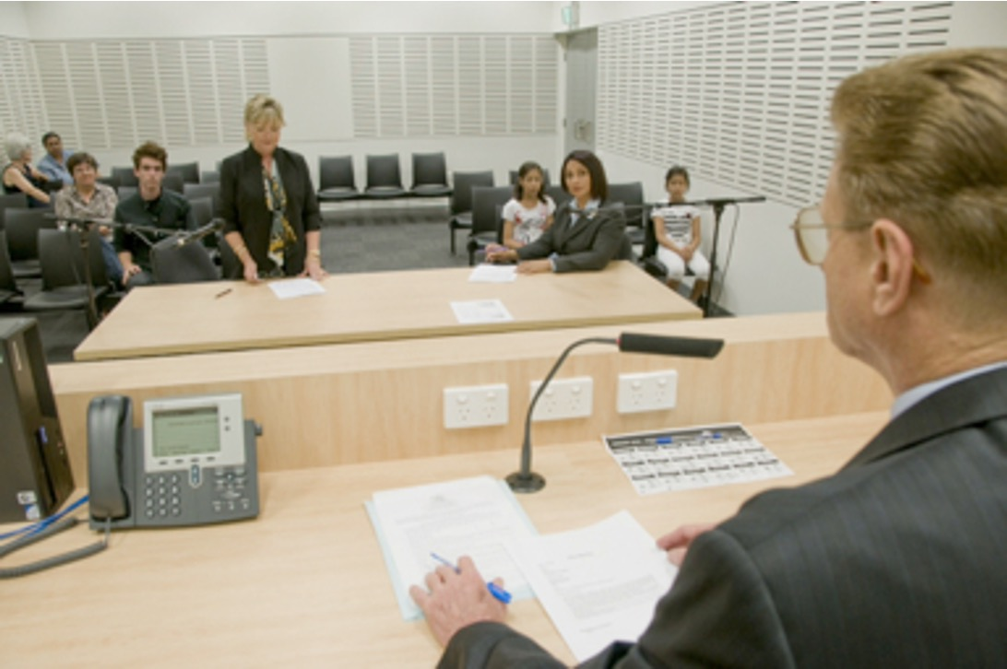
Termination Process:
3. NCAT Hearing
Will receive notice of conciliation hearing
Conciliation hearing – first hearing in the NCAT
process. NCAT will ask both parties to try and
conciliate/negotiate to try and reach an agreement
If no agreement can be reached, the matter will
either be heard on the day, or adjourned for
formal hearing at later date.
Image source: Law Access NSW
Very important – always attend the hearing unless the
NCAT tells a tenant in writing that they do not need to attend.

Slide 10
Termination Process:
4. NCAT Orders – termination and possession
If NCAT agrees the tenancy should be terminated,
it will make termination and possession orders.
A new date will be set when the tenant is
required to give vacant possession of the premises.
If you think a wrong decision has been made,
seek advice ASAP about whether there are grounds Image source: Law Access NSW
to have the orders set aside or to appeal! Strict time limits for these actions.

Slide 11
Termination Process:
5. NCAT issues warrant for possession
If the tenant is still in the premises after the vacant possession date ordered by NCAT, the landlord can apply to NCAT for a warrant for possession.
Once NCAT issues a warrant for possession, it will be sent to NSW Sherriff’s Office.
The landlord and the Sherriff’s Office will book a time for the warrant to be executed – they don’t have to tell the tenant when this will be.
If notified that a warrant for possession has been issued, the tenant should pack a bag of all important documents, possessions and medications.

Slide 12
Termination Process:
6. Sheriff executes warrant for possession and locks are changed
When Sheriff turns up with warrant to be executed, very important to comply with the Sheriff.
Have a bag already packed with important documents and possessions, medications and other essential items.
Once the warrant has been executed by the Sheriff, any NCAT decision cannot be set aside. In limited circumstances it could still be appealed, out of time. Very hard to have a tenancy reinstated once a warrant has been executed.

Slide 13
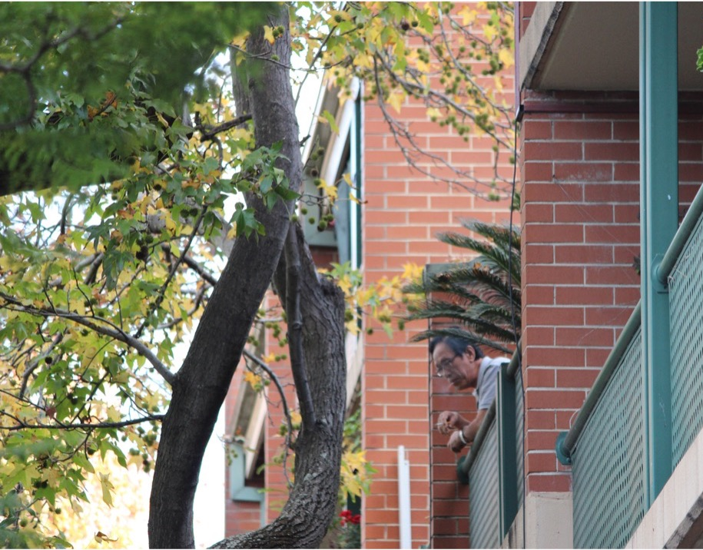

2
When can a tenant be evicted?

Slide 14
When can a tenant be evicted?
Most common types of evictions by landlords in NSW:
Breach of the residential tenancy agreement (including for rental arrears)
– 14 days written notice
End of fixed term agreement, no reason – 30 days written notice*
Periodic agreements, no reason – 90 days written notice*
Sale of premises – 30 days notice (only in periodic or ‘rolling’ tenancy agreements)
Remember – the tenant does not have to be out of the premises by the date on the Notice of Termination.
* Proposed changes to the Act will aim to require landlords to have a prescribed
reason to terminate a tenancy (to be discussed later in this webinar).

Slide 15
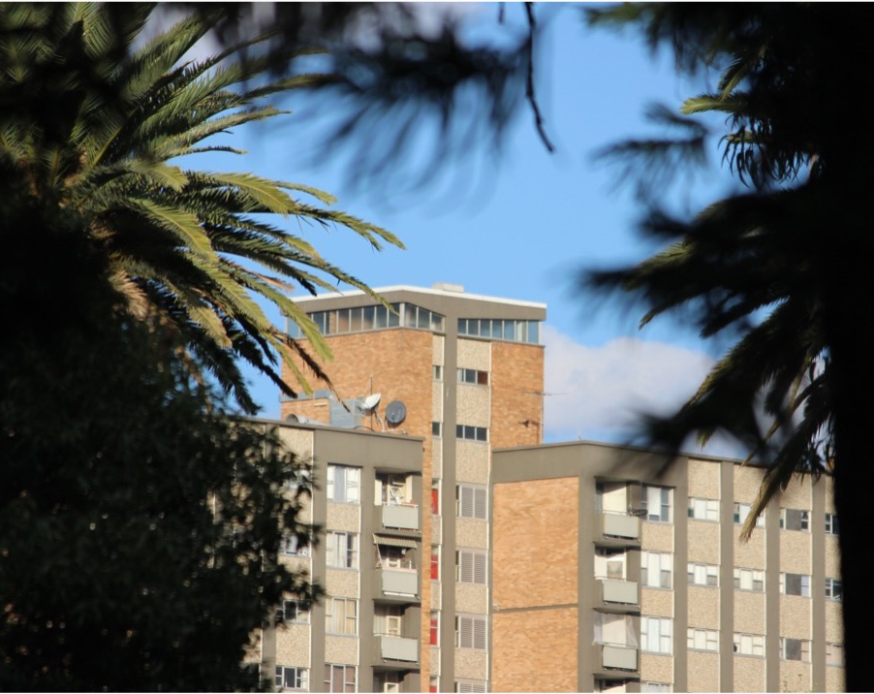
3
When can a tenant terminate the tenancy agreement?

Slide 16
When can a tenant terminate the tenancy agreement?
Periodic agreement, no reason – 21 days written notice (periodic agreements only, not allowed in fixed term)
End of fixed term, no reason – 14 days written notice
Landlord has breached the agreement – 14 days written notice (or application directly to NCAT under s 103)
If the premises has become uninhabitable – notice can take effect immediately
Domestic violence – notice can take effect immediately, needs to be accompanied by evidence such as ADVO or competent person statement.

Slide 17

4
Unlawful lockouts
Image: George Becker, pexels.com

Slide 18
Unlawful lockouts
Landlords cannot just change the locks and kick a tenant out of the premises.
The proper process discussed at the beginning of the webinar must be followed.
Only the Sheriff of NSW can execute a warrant for possession.
A person who unlawfully locks out a tenant can face a penalty of up to $22,000.

Slide 19
Reforms to Residential Tenancies Act (RTA):
‘no grounds evictions’
NSW Government has recently announced reforms to RTA following an election promise to end ‘no grounds evictions’.
We don’t know exactly what the reforms will look like or whether they will apply to existing agreements.
Likely to include specified grounds on which a landlord can terminate a tenancy, rather than being able to end a fixed-term or periodic agreement ‘for no reason’ (as under the current legislation).

Slide 20
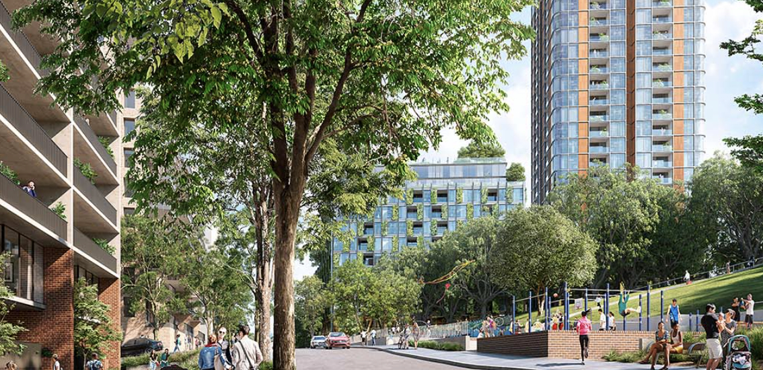
Waterloo South re-development
& relocations
A quick note for tenants affected by public
housing relocations in Waterloo South:
Tenants have recently been notified that the
development partner for the Waterloo South
re-development has been announced.
At this stage, the relocations are not going to Image : Planning NSW
commence until at least mid-2025.
Tenants need to be given at least 6 months’ notice before being relocated, and these notices are not expected to be issued until the beginning of 2025.

Slide 21

Questions...
& answers
Resources: rlc.org.au/training/evictions

Slide 22

Information & advice for tenants
www.tenants.org.au
fact sheets and sample letters >>>>>
free confidential legal advice for tenants
– to find you Tenants Advice & Advocacy Service,
enter your suburb or town >>>>>

Slide 23

Community legal education - free webinars & recordings rlc.org.au/training
Nick Manning: education@rlc.org.au

Slide 24

Your feedback is important to us! rlc.org.au/feedback or scan the QR code >>>

