Slide 1
21 August 2024
Help! My Client has Problem Debts #3:
Strategies for Dispute Resolution
Amelia Klein
Solicitor, Credit, Debt & Consumer Law

Slide 2
Amelia Klein
Solicitor,
Credit, Debt & Consumer Law
Redfern Legal Centre

Slide 3
Acknowledgement of Country

Slide 4

Outline
Dispute Resolution​ Options
Tips and Tricks
Trauma-Informed Dispute Resolution
Questions
Resources:
rlc.org.au/training/resources/debts

Slide 5
Content Warning

Slide 6

1
Dispute Resolution Options

Slide 7

Dispute Resolution Options
  Negotiation – Internal Dispute Resolution
  Mediation
  Arbitration
  Conciliation
  Judicial Determination – Court or Tribunal
  Status Quo
  Graphic: Tom Parsons on https://unsplash.com
Alternative Dispute Resolution

Slide 8
Negotiation
  Recent ASIC report highlights what we already know – individuals face barriers when attempting to negotiate outcomes with providers.
  Many organisations have specialist channels available
  for financial counsellors and community workers.
  Potential opportunities for escalating within
  organisations eg. Customer Advocate for banks.
  Internal and external standards apply
  Can still negotiate if in other stages.

Slide 9
Alternative Dispute Resolution
  For our purposes: External Dispute Resolution
  Can include both settlement by agreement (such as conciliation) and determination (such as AFCA final determination)
  In this space: free, compulsory for business, flexible in terms of evidence and capable of making binding decisions against the business; stops more serious enforcement
  Often have long delays associated with final decisions and have limited/capped outcomes

Slide 10
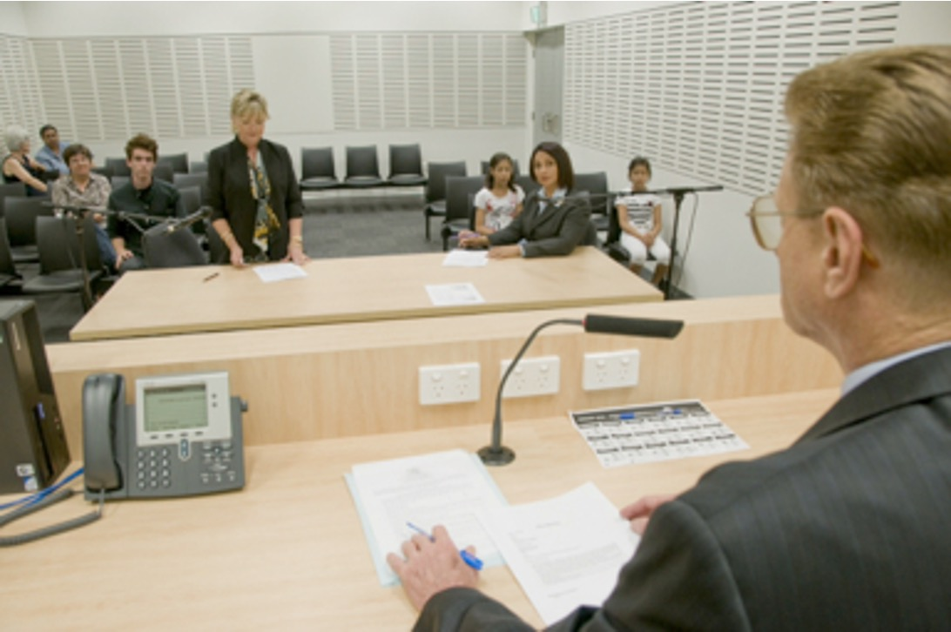
Court/Tribunal
  Will make a binding decision based on the evidence
  and legal argument.
  May have strict(er) timelines, and rules of evidence.
  Successful party can be ordered to be paid legal costs.
  Decision is determined by a third party.
  High risk, potentially higher reward than ADR.
  Often has long delays before final decisions.
  Image source: Law Access NSW
Notes:
Include a note on appeals

Slide 11

Status Quo
  Not all disputes escalate and not all
  disputes have substantive effects
  on our lives.
  Sometimes, the best advice is to
  do nothing.
Notes:
Include a note on appeals

Slide 12

2
Tips & Tricks

Slide 13
Tips & Tricks – Practicality
How much detail is needed?
What are the client’s goals?
What are the business’s legal and other obligations?
What is the evidence?
What is the cost?
What is the WATNA?
What is the BATNA?
Are you over-complicating it?
Notes:
Include a note on appeals

Slide 14
Case Study - Joel
Joel is a 77 year old man who received a bill from Vodafone in the mail saying he’d been referred to a debt collector for a $800 debt. He didn’t understand why.
Joel did not speak English fluently, was reliant on the aged pension and managed most of his expenses through Centrepay deductions.
When we requested documents, Vodafone was unable to provide some, but indicated it was for a tablet that Joel conceded he had purchased.
We sent a three line email outlining why we were insisting on the documents being provided given our concerns. Vodafone immediately made an offer to waive the amount outstanding and that Joel could retain the tablet.

Slide 15
Case Study – Serena
Serena had experienced domestic and family violence over a six year relationship. She had been listed as a director of a company without her knowledge or consent.
Serena is receiving:
Debt collector letters for a credit card her ex had taken out in her name.
Letters from a lawyer relating to a supplier contract she’d allegedly signed a personal guarantee for.
Texts from Cigno.
Letters about an electricity bill she can’t pay.
There are different potential outcomes for each of these debts.
The client may have different goals for each of these debts.
The organisations have different legal and policy-based obligations and may have different approaches.
This can lead to different practical strategies for each of the debts.

Slide 16

Tips & Tricks – Negotiation Skills
  Persuasion
  Clarity
  Composure
  Planning & preparation
  Confidence
  Willingness to walk away

Slide 17
Case Study – Serena
Serena had experienced domestic and family violence over a six year relationship. She had been listed as a director of a company without her knowledge or consent.
Serena is receiving:
Debt collector letters for a credit card her ex had taken out in her name.
Letters from a lawyer relating to a supplier contract she’d allegedly signed a personal guarantee for.
Texts from Cigno.
Letters about an electricity bill she can’t pay.
How can each of the negotiating skills mentioned assist you with the issues that you face with each of these debts?

Slide 18

3
Trauma-informed dispute resolution

Slide 19
We operate in a system that is not
trauma-informed.
How can we practice in a way that is?

Slide 20
Trauma-Informed Dispute Resolution
Know the limits of what you can offer. Do not promise something that the process cannot provide.
Keep the client informed, and let them decide how much they want to participate.
Balance advocacy and practicality.
Decide when to push back on inappropriate requests for information.
Contribute to reform and upskilling.
Gather information early.
Consider your best option: responsible lending complaint, compassionate framing or practical position?

Slide 21

Questions...
& answers
Resources: rlc.org.au/training/resources/debts

Slide 22
Free, confidential legal advice
Legal Aid (NSW) 1300 888 529
www.legalaid.nsw.gov.au
National Debt Helpline 1800 007 007
www.ndh.org.au
Community legal centres
www.clcs.org.au/legal-help
rlc.org.au/training/resources/debts

Slide 23
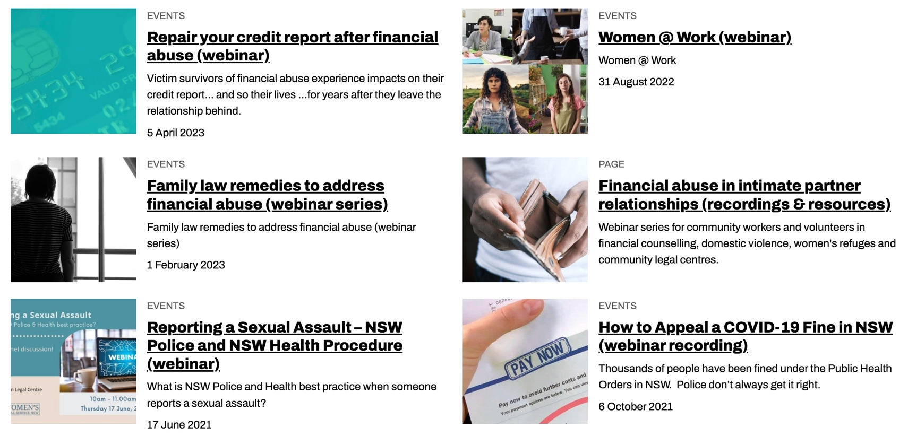
Community legal education - free webinars & recordings rlc.org.au/training
Nick Manning: education@rlc.org.au

Slide 24
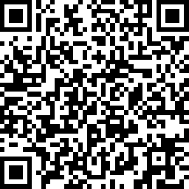
Your feedback is important to us! rlc.org.au/feedback or scan the QR code >>>

