Slide 1
Resolving financial abuse legal issues:
Fringe lenders
15 August 2022
Rebecca Campbell
Solicitor

Slide 2

Rebecca Campbell
Solicitor
Financial Abuse Service NSW
Redfern Legal Centre

Slide 4
Outline of today’s webinar
Overview of fringe lending and financial abuse
Regulated credit: Payday Loans and Personal Loans
Unregulated credit: Buy Now Pay Later and wage advances
Getting an outcome
Case Study
Policy, law reform and capacity building
Questions and further resources
RESOURCES: www.rlc.org.au/training/resources/financial-abuse

Slide 5

Image: Susan Wilkinson on unsplash.com
Fringe Lending and Financial Abuse

Slide 6
What is financial abuse?
Financial or economic abuse is a form of domestic violence where an abuser uses money as a means to gain power and to control their partner.
Domestic violence is “a pattern of abusive behaviour in an intimate relationship or other type of family relationship where one person assumes a position of power over another and causes fear… It is often referred to as a pattern of coercion and control.” (1800RESPECT)
There is no single agreed legal definition of domestic violence in Australia.

Slide 7
The subtleties of financial abuse
Can often be disguised as financial hardship or accepted as part of traditional gendered or cultural financial arrangements.
Doesn't necessarily end with the relationship: consequences of financial abuse can continue for years, especially if the financial abuse has negatively impacted their credit score or eroded their financial security.
Survivors can have no choice but to consolidate debts or take out payday loans to cover their living expenses, even years after the relationship.

Slide 8
How we assist
Free, confidential legal advice (via telephone, Zoom, face-to-face)
Co-advice appointments with experts in family law & credit / debt / consumer law
Representation in eligible cases
Available to all people in NSW who have experienced financial abuse in an intimate partner relationship
Lawyers are trauma informed, understand safety risks and the complexities of abusive relationships
Non-legal needs and social support referrals

Slide 9
What are fringe lenders?
Buy now pay later
Wage advance services
Payday lenders
Non-bank lenders

Slide 10
Financial abuse and fringe lending
Easy to apply for fringe lending products
Don’t require a good credit score
Some don’t report to credit reporting agencies
Harder to negotiate with fringe lenders
High fees, charges and interest

Slide 11
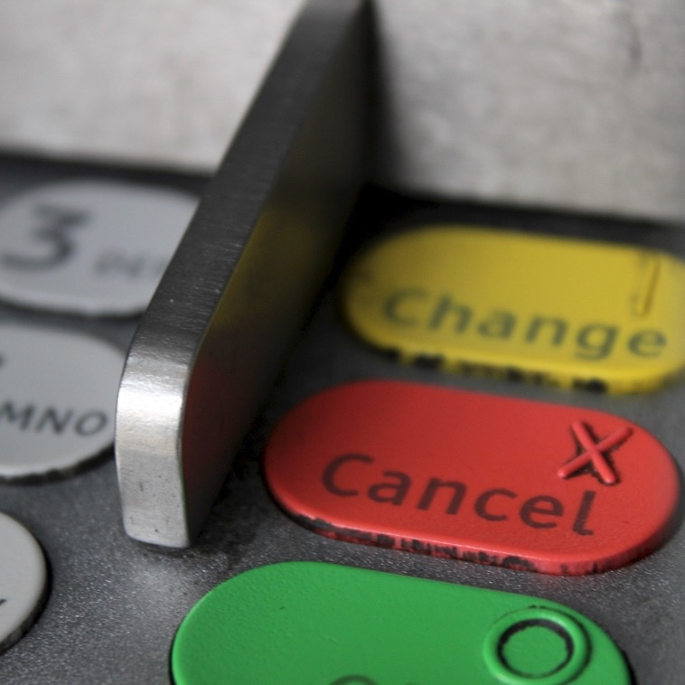
2. Regulated Credit
The National Consumer Credit Protection Act applies.
Image: Chitra Rangarajan, RLC

Slide 12
Regulated fringe credit
Payday loans
Personal loans
There is a presumption that credit is covered by the NCCPA

Slide 13
Legal framework
The National Consumer Credit Protection Act applies
  Chapter 3: responsible lending obligations
  Schedule 1, s76: unjustness
Internal and external dispute resolution

Slide 14
Cigno
The story so far
The recent Federal Court decision
What the position now is

Slide 15

Image: Susan Wilkinson on unsplash.com
3. Unregulated Credit
The National Consumer Credit Protection Act
does not apply.

Slide 16
Unregulated fringe credit
Buy Now Pay Later products
Wage advance services
Any short-term credit under 62 days where the fees and charges are not more than 5% of the amount of credit and the maximum interest charges are 24% p.a.

Slide 17
Legal framework
ASIC Act: s12 unconscionable conduct
Case law: duress, contract formation
Contracts Review Act: s7 unjustness
BNPL Voluntary code of practice
Some use AFCA for external dispute resolution

Slide 18

4. Getting
an
outcome
Image: Tom Parsons on unsplash.com

Slide 19
Potential complaints
Client was coerced into signing a credit contract (e.g. credit card, personal loan, car loan etc.) – typically in their name only
Client’s signature was forged on loan documents
Client got no benefit from the credit contract (e.g. client’s ex partner used their afterpay account and the client obtained no benefit)
Client didn’t understand the terms of the contract
Client couldn't afford the contract at the time it was approved

Slide 20
Potential outcomes
Reducing the amount to pay
Full or partial waiver
Waiver of interest and/or fees
Cancellation of account
Waiver of cancellation fees
Compensation
Compensation for financial and non-financial loss
Refund of amounts paid
Extending the time to pay
Moratorium (short or long term hold on repayments)
Hold on fees / interest / charges
Payment plan
Credit reporting
No default listing
Removal of adverse credit information e.g. defaults, enquiries, repayment history information

Slide 21
Practical tips
Identifying a fringe lending financial abuse matter
Information gathering
Negotiation tactics
What can I do within my role?

Slide 22
Credit report corrections
Debts that occurred in the context of financial abuse are not an accurate reflection of the client's creditworthiness
Negotiation should include the lender agreeing to take steps to remove any adverse information from a client’s credit report

Slide 23
Service bans
Some lenders will ask the client to consent to a service ban
Discuss with the client: depends on their objectives
Financial counsellors – a better option in many cases!

Slide 24
Urgent legal issues
Court proceedings have been commenced
A Statement of Claim has been served on the client
There is a default judgment against the client
There is a garnishee order on the client’s bank account or wages
Default notice has been issued on a loan secured by property (e.g. a mortgage)
Client’s savings or assets are being eroded quickly

Slide 25

5. Case study
Image: RLC

Slide 26

Sam’s story
Sam’s partner Alex insisted on living a lifestyle that their income couldn’t support
Sam’s credit score was good, but Alex always wanted the money fast, so pressured Sam into taking out a number of fringe lending contracts, including a $2,000 debt to LaterBuy and a $1,000 wage advance from BeforeCash.
Sam’s credit report shows fringe lending products that Sam didn’t recognise, including a including a $5,000 loan with Buzz. Sam thinks Alex took these out using Sam’s phone, as Alex knew the passcode.
Sam owes a lot more than the amount initially borrowed and can’t afford repayments.

Slide 27
Buzz Loan
Regulated by the NCCPA
Part 3 NCCPA: Responsible Lending
S76 National Credit Code: Unjustness
AFCA available
Remedy: waiver of balance owing, correction of credit report.

Slide 28
LaterBuy Debt
Not regulated by the NCCPA
Common law: duress and contract formation
Contracts Review Act: s7 unjustness
BNPL Voluntary Code of Practice
AFCA – required to be a member if they have signed the voluntary code
Remedy: waiver of balance owing, correction of credit report

Slide 29
BeforeCash Advance
Not regulated by the NCCPA
Common law: duress and contract formation
Contracts Review Act: s7 Unjustness
ASIC Act: s12 unconscionable conduct
Hardship and compassionate circumstances
AFCA not available
Remedy: waiver of balance owing, correction of credit report.

Slide 30
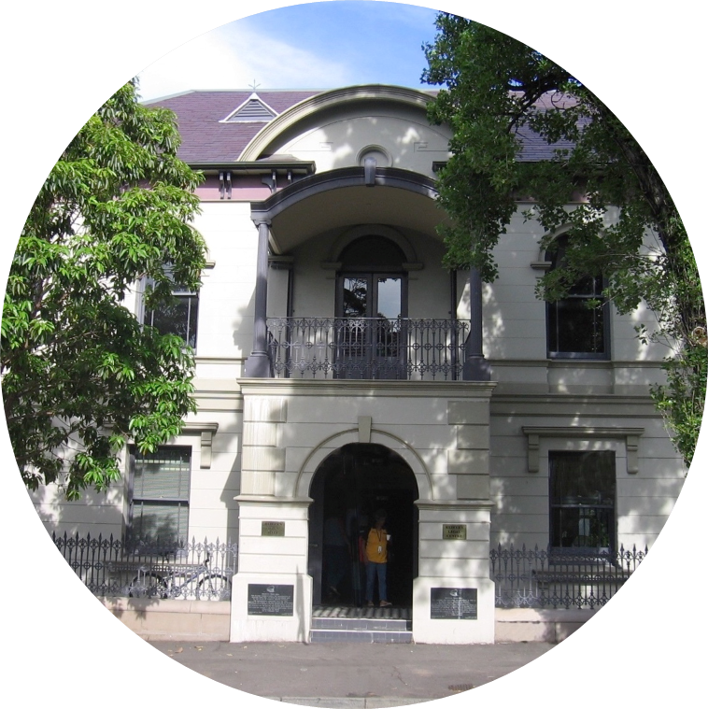
6. Policy,
Law Reform & Capacity Building
Image: RLC

Slide 31
Capacity building work
Raise awareness among community sector workers, the general public, industry, and Government
Provide a central source of information
Establish a state-based network of community organisations to collaborate at the NSW level and nationally

Slide 32
Policy and law reform work
Submissions on policy development, reform and legislative change
Work with government, industry, regulators, ombudsman services and peak bodies to implement appropriate policies and procedures

Slide 33
Current policy work
More and more players entering the market
The government has committed to regulating BNPL and wage advance services
Treasury consultation underway
We are on the lookout for case studies that show consumer harm

Slide 34
7. Questions and further resources
Rebecca Campbell
Financial Abuse Service NSW
Redfern Legal Centre
RESOURCES: www.rlc.org.au/training/resources/financial-abuse

Slide 35
How to contact RLC’s
Financial Abuse Service NSW
*** Legal advice for NSW clients only ***
Call us: 0481 730 344
Email us: falsintake@rlc.org.au
Complete our online form: https://rlc.org.au/fals

Slide 36

Before You Go
Your feedback helps us improve our training.
Please stay with us for another 60 seconds…
Training: rlc.org.au/training
Enquiries: Nick Manning
education@rlc.org.au
This workshop is a guide to the law in Australia. It is not a substitute for legal advice. If you have a legal problem, seek legal advice from a legal centre or Legal Aid.

