Slide 1
Resolving Financial Abuse Issues:
Two Roads Diverged
Credit, Debt and Consumer Law, or Family Law, or both? Your questions answered!
Wednesday 21 July 2021
Maria Monastiriotis Jasmine Opdam
Accredited Family Law Specialist Credit, Debt & Consumer Lawyer

Slide 3
Outline
RLC’s Financial Abuse Service NSW
Understanding Financial Abuse
Remedies in family law
Remedies in credit, debt & consumer law
Q&A

Slide 4
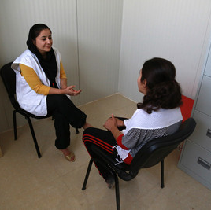
Financial Abuse Service NSW

Slide 5
How we can assist
Free, confidential legal advice (via telephone, face-to-face, Zoom)
Representation in eligible cases
Available to all people in NSW who have experienced financial abuse in an intimate partner relationship
Lawyers are trauma informed, understand safety risks and the complexities of abusive relationships

Slide 6
Co-advice model
When a client contacts our service, triage is done by our Legal Support Officer.
Depending on the client’s needs, we offer tailored appointments with:
  Family lawyer only
  Credit and debt lawyer only
  Both family lawyer and credit and debt lawyer (“co-advice”).
This collaborative approach to advice brings together experts in different areas of law to provide holistic advice about pathways for resolving the legal problem.
Access to our family law assistance is limited. We prioritise people who are not currently represented and are not eligible for other family law services.

Slide 7
Areas we advise on
Consumer credit (loans, credit cards)
Consumer law (complaints about products/services)
Debt recovery
Local Court process
Bankruptcy
Financial hardship
Family law financial matters
Superannuation
Insurance
Fines and toll debts
Banking disputes
Company law
Contract law

Slide 8
Non-legal needs
We provide referrals for:
Crisis accommodation
Immediate financial support
Domestic violence safety planning
Casework support
Psychological counselling
Financial counselling & empowerment

Slide 9

Understanding Financial Abuse

Slide 10
Previous webinars
Watch RLC’s previous webinars in the Financial Abuse series for free online:
Identifying financial abuse in intimate partner relationships and supporting victim survivors (July 2020)
Resolving financial abuse legal issues (September 2020)
https://rlc.org.au/training/resources/financial-abuse

Slide 11
What is financial abuse?
Financial or economic abuse is a form of domestic violence where an abuser uses money as a means to gain power and to control their partner
Domestic violence is “a pattern of abusive behaviour in an intimate relationship or other type of family relationship where one person assumes a position of power over another and causes fear… It is often referred to as a pattern of coercion and control” (1800RESPECT)
There is no single agreed legal definition of domestic violence in Australia

Slide 12
Common financial abuse issues #1
Partner refusing to contribute to joint debts (e.g. rent, mortgage repayments, car loans, school fees) or pay child support
Partner withdrawing money from a joint bank account or cutting off access to joint accounts
Partner transferring joint property into another person’s name to avoid a Family Law claim

Slide 13
Common financial abuse issues #2
Being coerced to sign documents, take out loans, sign personal guarantees or make false declarations
Identity theft (e.g. accounts fraudulently opened by a partner or ex-partner using personal information)
Partner taking control of finances and assets e.g. car, social security benefits, superannuation

Slide 14
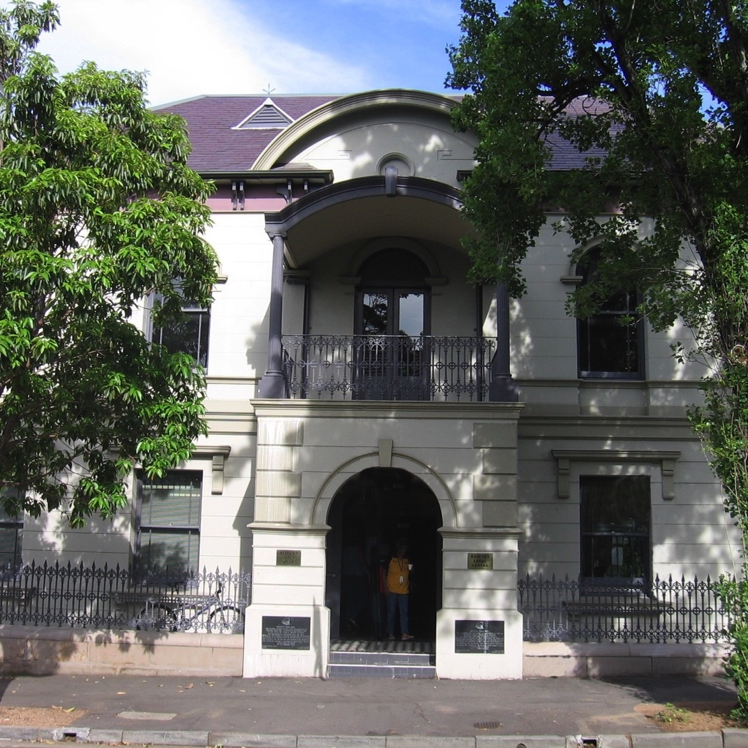
Remedies in family law

Slide 15
Family Violence in Family Law
The Family Law Act defines family violence as:
"violent, threatening or other behaviour by a person that coerces or controls a member of the person's family (the family member), or causes the family member to be fearful."
Section 4AB(1)

Slide 16
Examples include:
(g) unreasonably denying the family member the financial autonomy that he or she would otherwise have had; or
(h) unreasonably withholding financial support needed to meet the reasonable living expenses of the family member, or his or her child, at a time when the family member is entirely or predominantly dependent on the person for financial support;

Slide 17
Family law pathways
Property settlement
Spousal maintenance
Child support

Slide 18
Remedies available
Property Settlements (including setting aside transactions that defeat claims s106B)
Urgent, interim and Final Spousal Maintenance Orders
Child Support
Applications to set aside property orders (section 79A)
Applications for exclusive occupation of the home

Slide 19

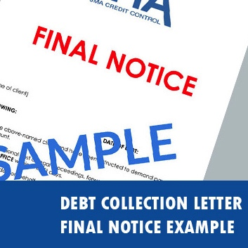
Remedies in credit, debt & consumer law

Slide 20
Credit, debt & consumer law pathways #1
Application for financial hardship assistance (e.g. debt waivers, payment plans)
Consumer complaint on the basis of:
  Breaches of the Consumer Credit Law
  Breaches of relevant industry guidelines and codes of practice

Slide 21
Credit, debt & consumer law pathways #2
External dispute resolution schemes (e.g. Australian Financial Complaints Authority, Telecommunications Industry Ombudsman, Energy and Water Ombudsman)
Request for fines to be withdrawn or written-off / waived
Debt recovery proceedings (typically through the Local Court)

Slide 22
Remedies available
Reducing the amount to pay
Full waiver
Partial waiver
Waiver of interest and/or fees
Severing liability
Cancellation of account
Waiver of cancellation fees
Refund of amounts already paid
Fines withdrawn, written off or reduced
Compensation
Financial loss
Non-financial loss
Additional credit (phone, utility contracts)
Extending the time to pay
Moratorium (short or long term hold on repayments)
Hold on fees / interest / charges
Payment plan
Credit reporting
No default listing
Removal of adverse credit information e.g. defaults, enquiries
Note: from July 2021, financial hardship information must be noted on consumers’ credit reports

Slide 23
How to contact us
Call us: 0481 730 344
Email us: falsintake@rlc.org.au
Complete our online form: https://rlc.org.au/fals

Slide 24
When we can’t assist
Elder abuse or financial abuse outside of intimate partner relationships – refer to the National Debt Helpline https://ndh.org.au/ 1800 007 007 or the Seniors Rights Service (NSW).
Credit, debt and consumer law problems that are not connected to financial abuse – refer to your local community legal centre or Legal Aid.
Family law issues where there are no interconnected credit and debt issues – refer to your local community legal centre or Legal Aid.

Slide 25
Q&A: Your questions answered
RESOURCES: www.rlc.org.au/training/resources/financial-abuse

Slide 26
Upcoming webinars in RLC’s Financial Abuse series
Resolving financial abuse issues: Telecommunications (3 August 2021)
Resolving financial abuse issues: Financial control after separation (15 September 2021)
Details and register here: https://rlc.org.au/training

Slide 27
Learn more about RLC’s work
Sign up for our eBulletin
www.rlc.org.au
Follow us
Facebook: @redfernlegal
Twitter: @RLC_CEO
Instagram: @teamRLC

Slide 28

Before you go
Your feedback helps us improve our training.
Please stay with us for another 60 seconds…
Training: rlc.org.au/training
Enquiries: Nick Manning
education@rlc.org.au
This workshop is a guide to the law in Australia. It is not a substitute for legal advice. If you have a legal problem, seek legal advice from a legal centre or Legal Aid.

